Slide 1
Demand Forecasting for E-Commerce
Infosys Springboard
Presented by : Sandipan Rakshit
duttabikram768@gmail.com
Date : 18th July, 2024

Slide 2

CONTENT
Problem Statement
Introduction
Exploratory Data Analysis –
Data Preprocessing
Check Missing values and Dropping Duplicates
Analysis of Outliers and replacement
Feature Engineering
Correlation Matrix
Linear Regression –
Effect of Clicks over Quantity
Effect of Facebook Impressions over Quantity
Facebook Impressions vs Clicks
Visualization –Regression –
Day, Week and Month wise Analysis of Quantity, Clicks and FB Impressions
Weekday vs Weekend analysis of Quantity, Clicks and FB Impressions
Trends aggregated plot
Time Series Analysis –
Stationary Test
ADF Statistics
ACF and PACF plot
Demand Forecasting Models –
I. AR II. MA III. ARMA IV. ARIMA
V. SARIMA VI. ARIMAX VII. SARIMAX
Multivariate Regression
Comparison of all Forecasting Models

Slide 3

PROBLEM STATEMENT
The realm of E-Commerce, demand forecasting plays a pivotal role in ensuring business success. This project aims to develop a demand forecasting model in an E-commerce business that predicts future product demand leveraging time series analysis and multivariate regression based on historical sales data, along with Google Analytics KPIs such as Google clicks and Facebook impressions, which are valuable indicators of customer interest.
Develop a robust model that predicts future product demand using historical sales data and Google Analytics KPIs such as Google clicks and Facebook impressions, ensuring accurate inventory management and sales strategies
Identify and analyze significant trends and seasonal patterns in sales data to understand market dynamics and predict recurring events' impact on demand.
Evaluate the effectiveness of Google clicks and Facebook impressions on sales, testing hypotheses related to the impact of online advertising and social media marketing on customer behavior.
Assess the correlation between past and future values of sales, clicks, and impressions to build effective autoregressive models, and explore the influence of lagged effects on current sales to understand delayed responses to marketing efforts.

Slide 4

INTRODUCTION
In the competitive and fast-paced world of E-Commerce, predicting product demand with accuracy is essential for businesses to thrive. Proper demand forecasting ensures optimal inventory management, reduces operational costs, and enhances customer satisfaction.
This project focuses on developing a sophisticated demand forecasting model that utilizes historical sales data alongside key performance indicators (KPIs) from Google Analytics, such as Google clicks and Facebook impressions.
By leveraging advanced time series analysis and multivariate regression techniques, the model aims to uncover insights into market trends, seasonal patterns, and the effectiveness of online advertising. Identifying the correlation between past and future sales, clicks, and impressions will help in building precise autoregressive models and understanding the lagged effects of marketing efforts. Ultimately, this project aspires to provide E-Commerce businesses with actionable insights and accurate demand forecasts, enabling them to make informed decisions, optimize their operations, and improve their market strategies.

Slide 5

INTRODUCTION
EXPLORATORY DATA ANALYSIS
Three Excel sheets are given to us –
ProductA_google_clicks.xlsx (contains Day Index and corresponding Google Clicks data)
ProductA_fb_impressions.xlsx (contains Day Index and corresponding Facebook Impressions data)
ProductA.xlsx (contains Day Index and corresponding Quantity Sales data)
Merging Data Set through EDA
We have merge all three data sets through Exploratory Data Analysis into a Data set “Merged_product.xlsx” by using Left Join and we got 212 rows and 4 columns ( ‘Quantity’, ‘Clicks’ and ‘Impressions’ )
‘Day Index’,
Day Index Quantity Clicks Impressions
0 2021-12-01 14 445 620
1 2021-12-02 10 433 890
2 2021-12-03 13 424 851
3 2021-12-04 22 427 881
2021-12-05 33 451 678
Here ‘Quantity’ is the target or dependent column and ‘Clicks’ and ‘Impressions’ are the independent column.
In the competitive and fast-paced world of E-Commerce, predicting product demand with accuracy is essential for businesses to thrive. Proper demand forecasting ensures optimal inventory management, reduces operational costs, and enhances customer satisfaction.
This project focuses on developing a sophisticated demand forecasting model that utilizes historical sales data alongside key performance indicators (KPIs) from Google Analytics, such as Google clicks and Facebook impressions.
By leveraging advanced time series analysis and multivariate regression techniques, the model aims to uncover insights into market trends, seasonal patterns, and the effectiveness of online advertising. Identifying the correlation between past and future sales, clicks, and impressions will help in building precise autoregressive models and understanding the lagged effects of marketing efforts. Ultimately, this project aspires to provide E-Commerce businesses with actionable insights and accurate demand forecasts, enabling them to make informed decisions, optimize their operations, and improve their market strategies.

Slide 6
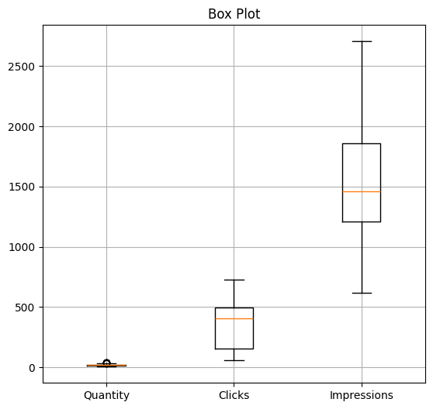
Check missing values
There are no missing values in ‘Quantity’, ‘Clicks’ and ‘Impressions’.
Therefore no imputation needed.
Check for Duplicate values
No row dropped after checking for duplicate values, Hence no duplicate values are found.
Distribution and relationships of Quantity, Clicks, and Impressions in the dataset.
The box plot shows that Quantity is small and consistent, Clicks are moderate and more spread out, while Impressions are large and widely distributed. Impressions typically lead to Clicks, which in turn lead to Quantity, reflecting a typical online sales funnel. This indicates a progression from many Impressions to fewer Clicks, and even fewer Quantities. The relationship highlights the hierarchical nature of these metrics in marketing.

Slide 7
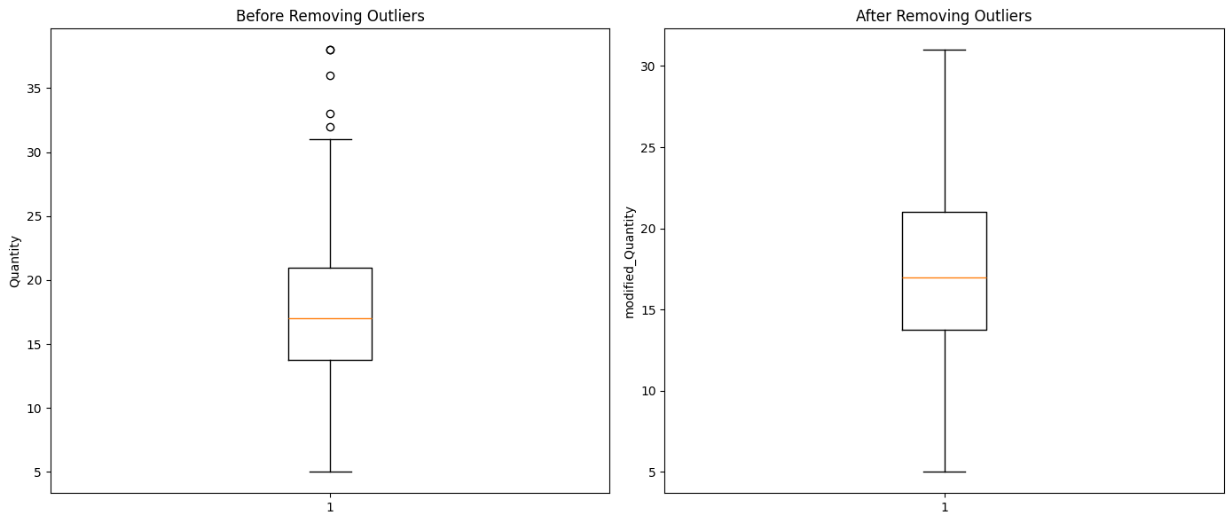
Analysis of Outliers
By through analysis of Outliers we get to know that ‘Quantity’ have 5 outliers and ‘Clicks’ and ‘Impressions’ does not have any outliers.
So we replace the outliers of ‘Quantity’ with 95th percentile.
Quantity before removing Outliers vs after removing Outliers
The box plots illustrate the quantity data before and after outlier removal. Initially, the data shows a median around 16, with several outliers above 30, and a range extending from 5 to 30. After removing outliers, the modified data maintains the median around 16 but exhibits a more compact range from 5 to 25, with no extreme values. This adjustment helps in creating more robust models by preventing extreme values from skewing the analysis, which is essential for accurate demand forecasting.

Slide 8
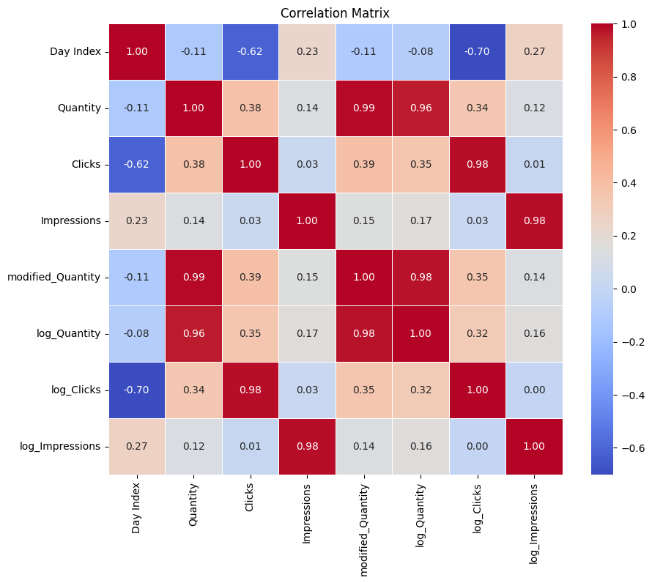
Feature Engineering
In feature engineering, we have extracted several columns to enrich the dataset: ‘Day Index’, ‘Year’, ‘Month’, ‘Day’, ‘Quantity’, ‘Clicks’, ‘Impressions’, ‘modified_Quantity’, ‘log_Quantity’, ‘log_Clicks’, and ‘log_Impressions’.
Correlation matrix
`Quantity` is highly correlated with both `modified_Quantity` (0.99) and `log_Quantity` (0.96), while `Clicks` and `Impressions` have strong correlations with their logarithmic counterparts (0.98 each). `Day Index` shows moderate negative correlations with `Clicks` (-0.62) and `log_Clicks` (-0.70), while `Quantity` and `Clicks` have moderate positive correlations (0.38 and 0.39, respectively).

Slide 9
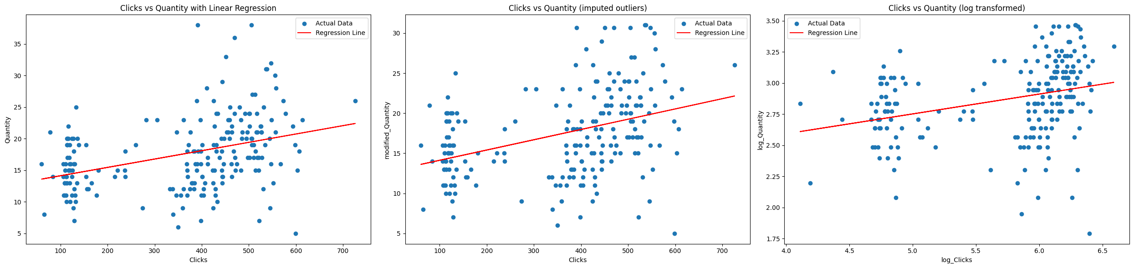
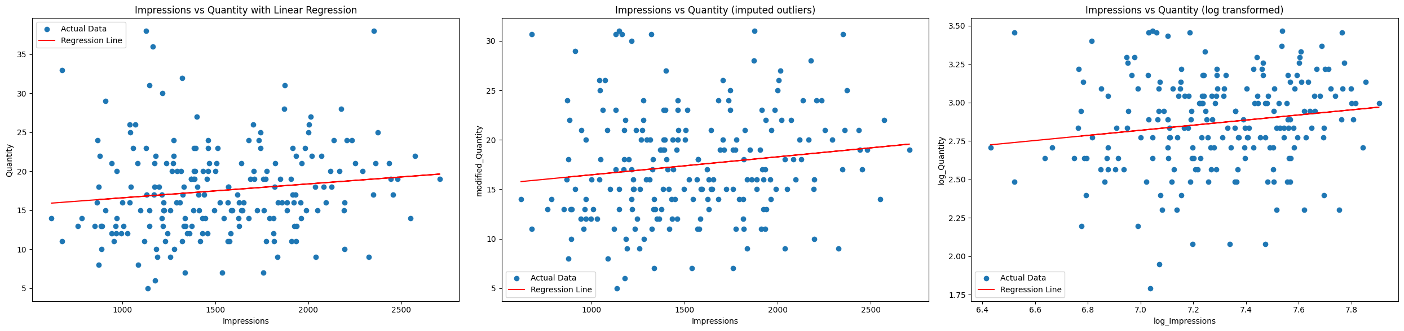
Linear Regression
Effect of Clicks over Quantity
The slope of the linear regression model for original data is: 0.0132
The slope of the linear regression model for data with imputed outliers is: 0.0128
The slope of the linear regression model for log transformed data is: 0.1596
Here we can see that slopes are positive which means that Quantity increases when Clicks increases.

Slide 10
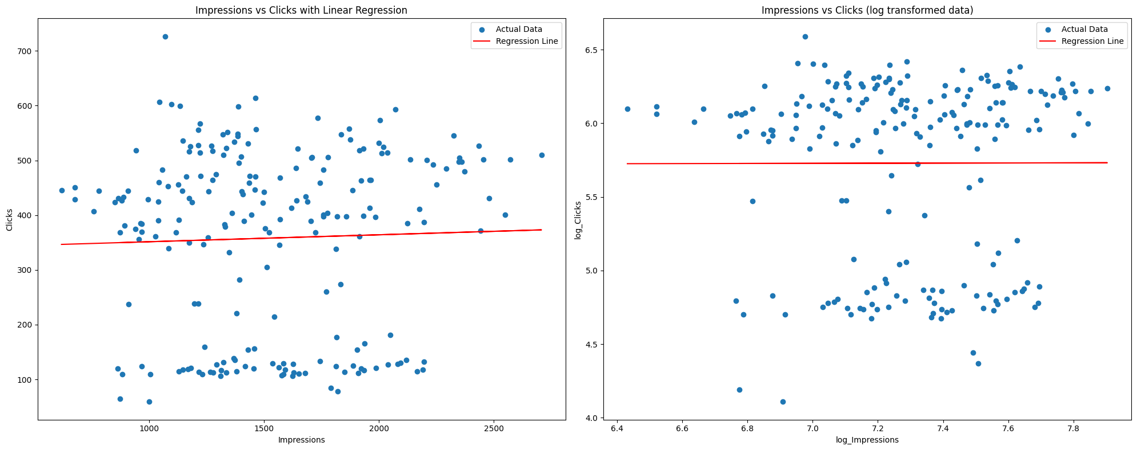
Effect of Impressions over Quantity
The slope of the linear regression model for original data is: 0.0019
The slope of the linear regression model for data with imputed outliers is: 0.0019
The slope of the linear regression model for log transformed data is: 0.1663
Here we can see that all slopes are positive which means that Quantity slightly increases when Clicks increases.

Slide 11
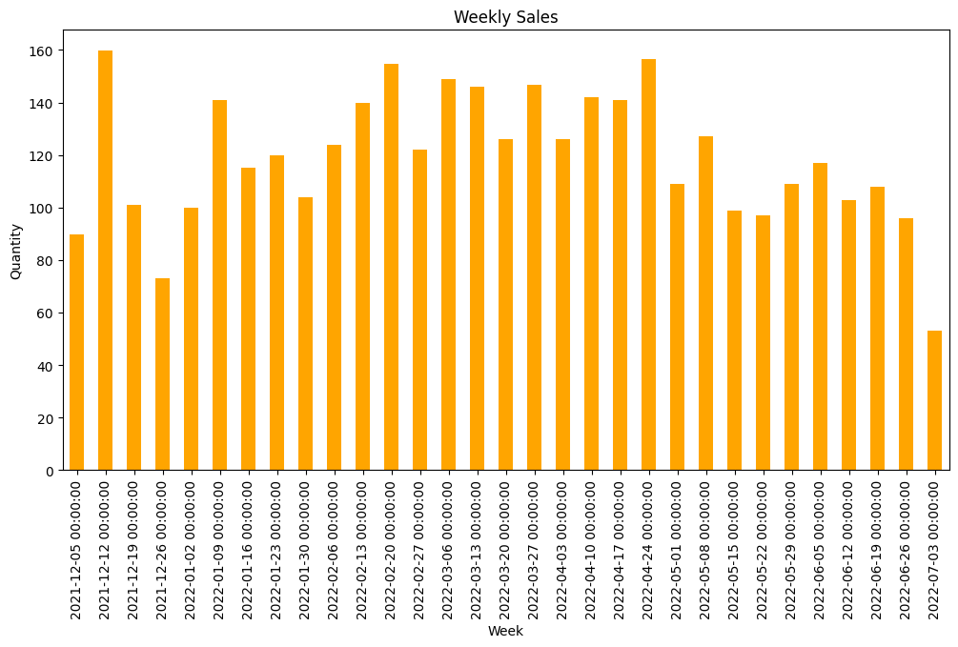
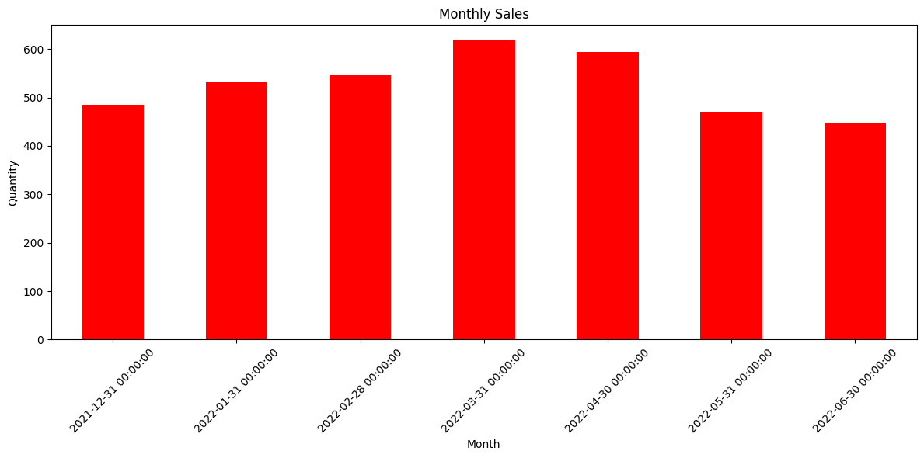
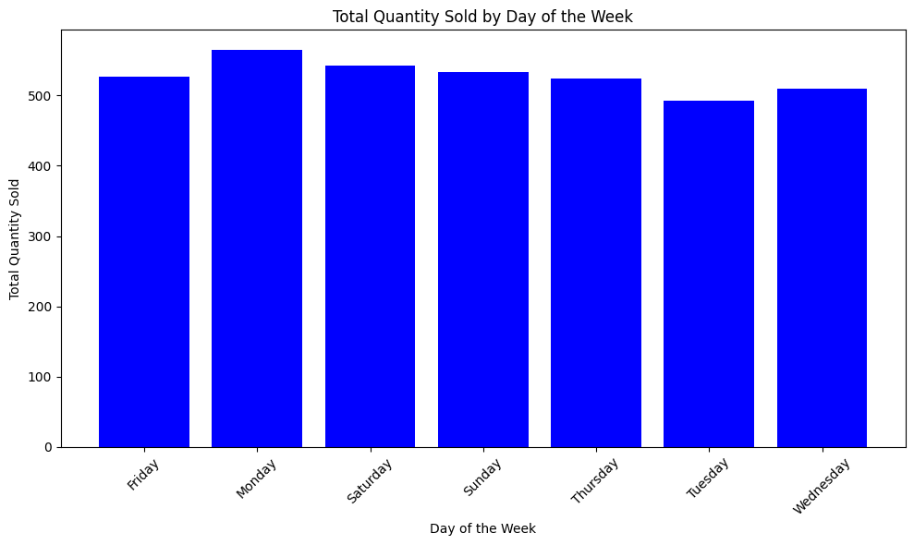
Effect of Impressions over Clicks
The slope of the linear regression model for original data is: 0.0127
The slope of the linear regression model for log transformed data is: 0.0042
Here we can see that all slopes are positive which means that Clicks slightly increases when Impressions increases.

Slide 12

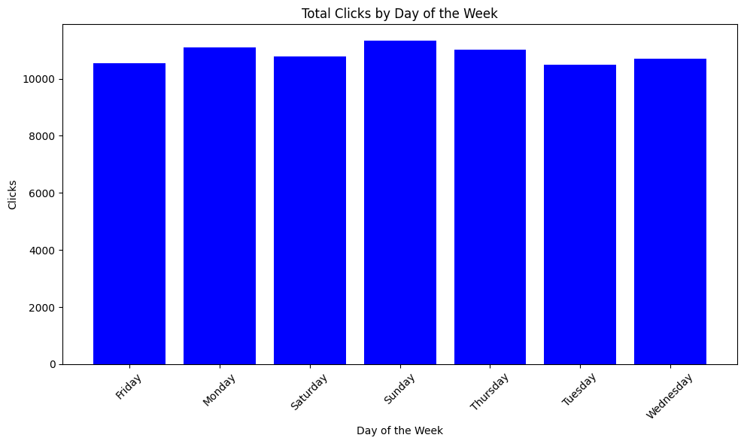
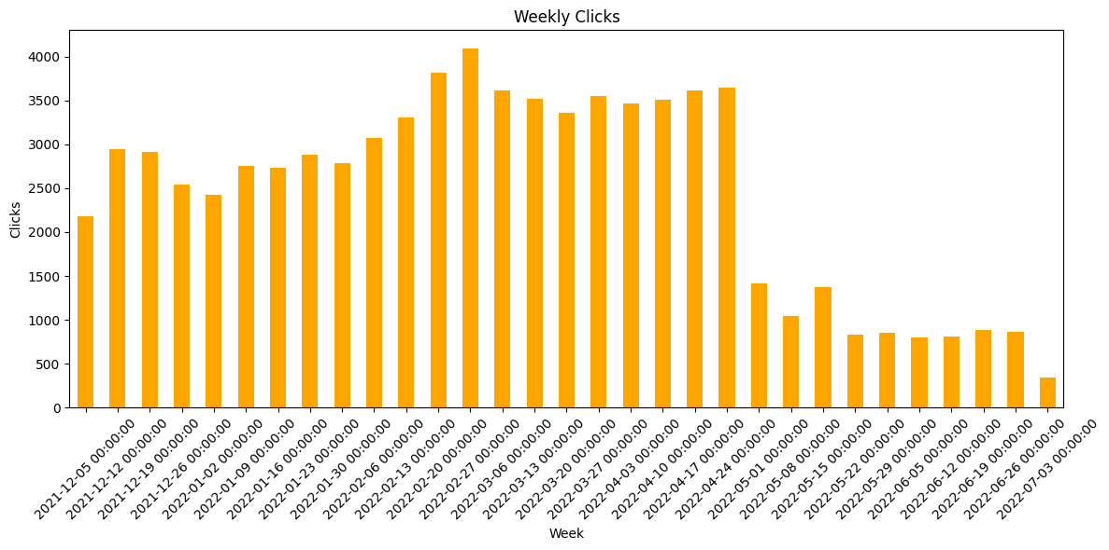
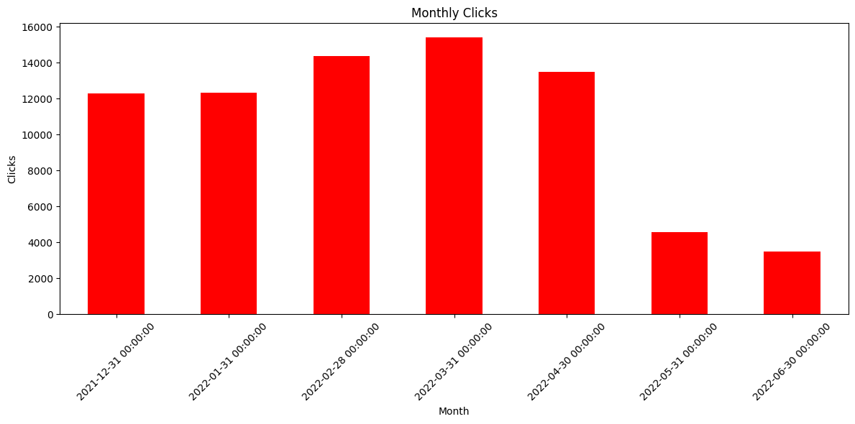
VISUALIZATION
Day wise Quantity
Week wise Quantity
Month wise Quantity
Monday have highest sales followed by Saturday and Sunday.
Week 2021-12-12 with 159.67 Quantity sold have the highest sales.
Month of March 2022 had the highest sales with 618.67 units sold.

Slide 13
VISUALIZATION
Day wise Clicks
Week wise Clicks
Month wise Clicks
According to the plot we can see that Sunday have high Clicks.
Week starting on 2022-02-27 had the highest clicks with 4095 clicks.
Month of March 2022 had the highest Clicks with 618.67 Clicks.

Slide 14
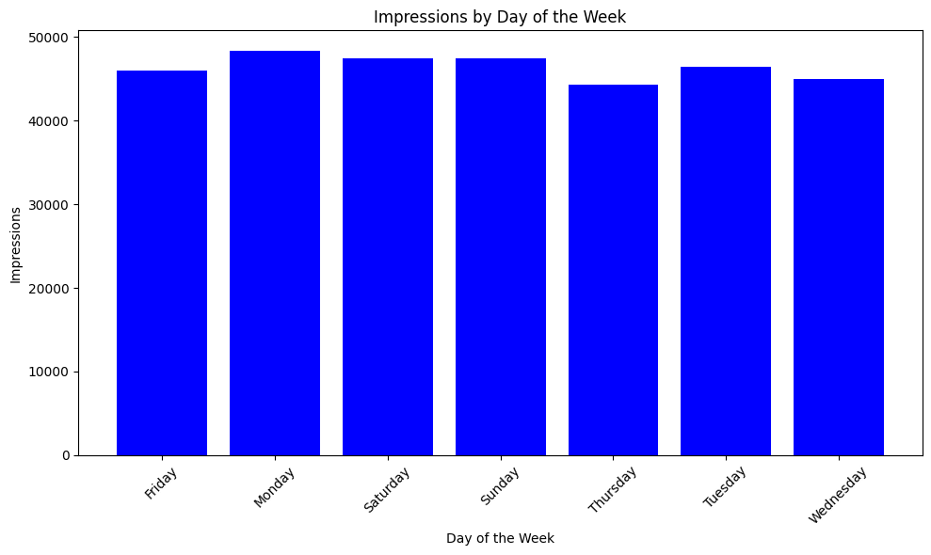
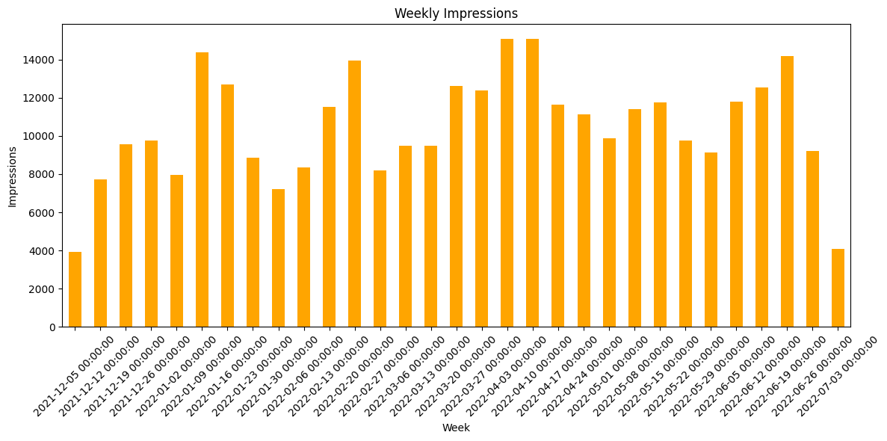
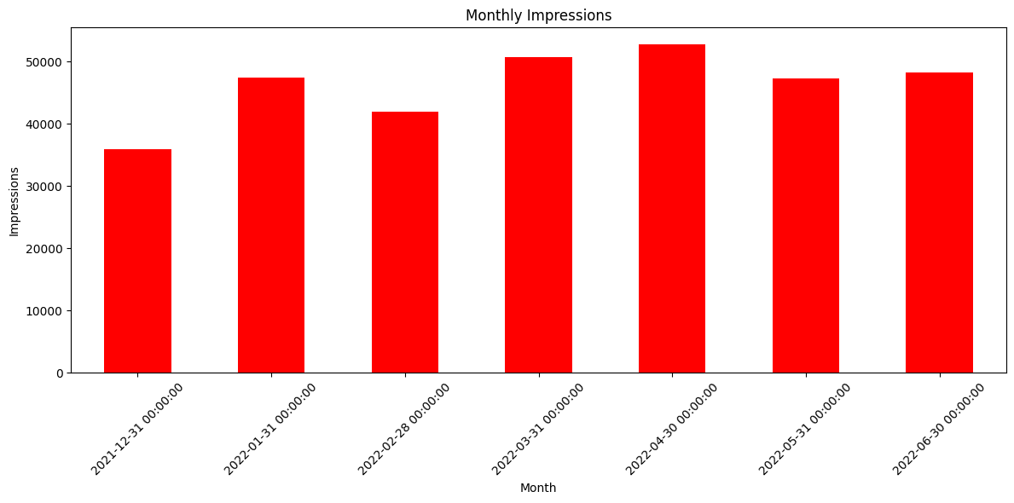
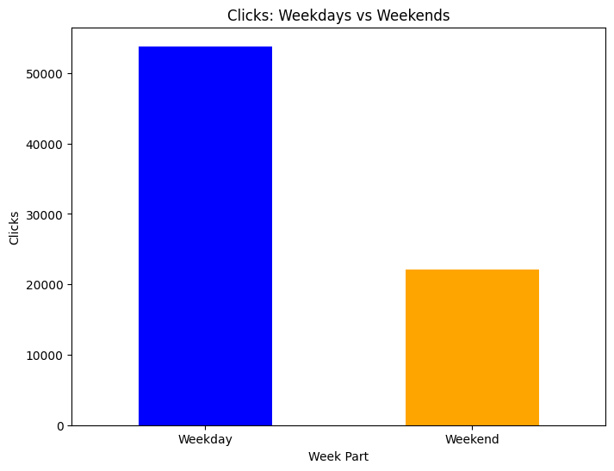
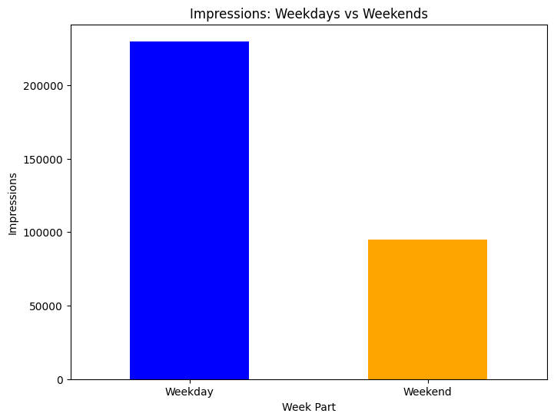

VISUALIZATION
Day wise Impressions
Week wise Impressions
Month wise Impressions
According to the plot we can see that Monday have high Impressions.
Week starting on 2022-04-10 had the highest Impressions with 15096 Impressions.
Month of April 2022 had the highest Impressions with 618.67 Impressions.

Slide 15
Impact of Weekdays vs Weekend
Quantity
Clicks
Impressions
Here we can see that all ‘Quantity’, ‘Clicks’ and ‘Impressions’ in Weekdays are greater than ‘Weekend’.

Slide 16
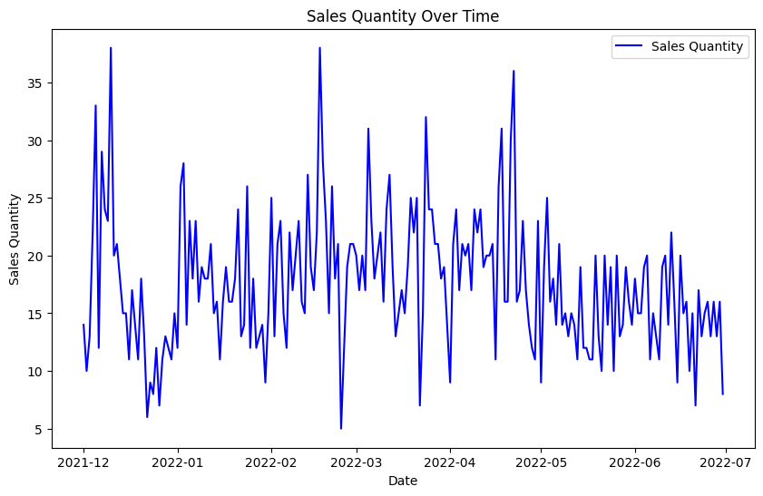
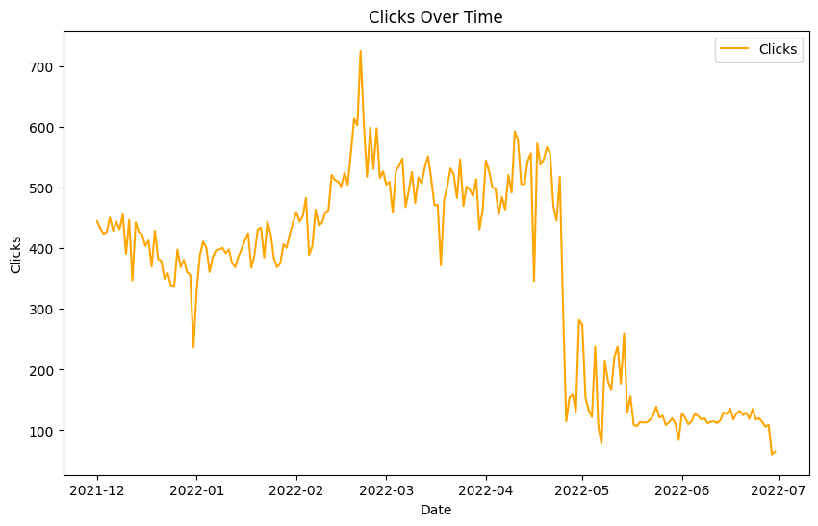
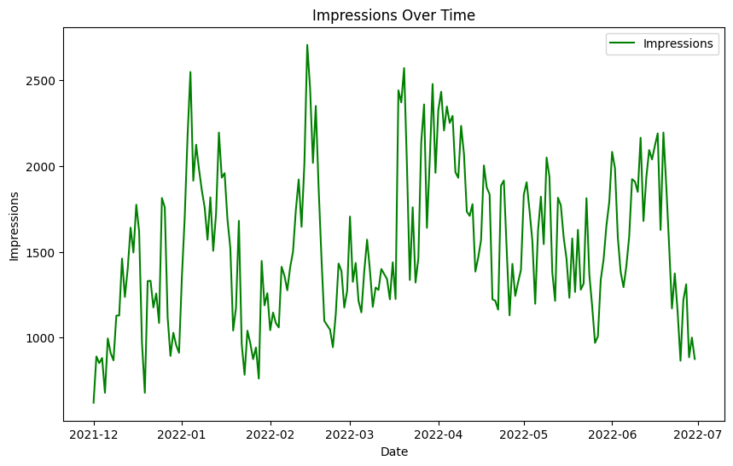
Trend
Sales Quantity over Time
Clicks over Time
Impressions over Time
The sales quantity shows high volatility, with significant spikes and drops throughout the observed period. There appears to be a decreasing trend in sales quantity towards the end of the time series, particularly after April 2022.
The number of clicks shows a peak around February 2022, followed by a steep decline and stabilization at a lower level from May 2022 onwards. This suggests a significant drop in user engagement or interest over time.
Impressions fluctuate significantly over time, with notable peaks around January and March 2022, followed by a more stable period with lower peaks and troughs from April to July 2022. This indicates varying visibility or reach, with periods of higher activity followed by stabilization.

Slide 17
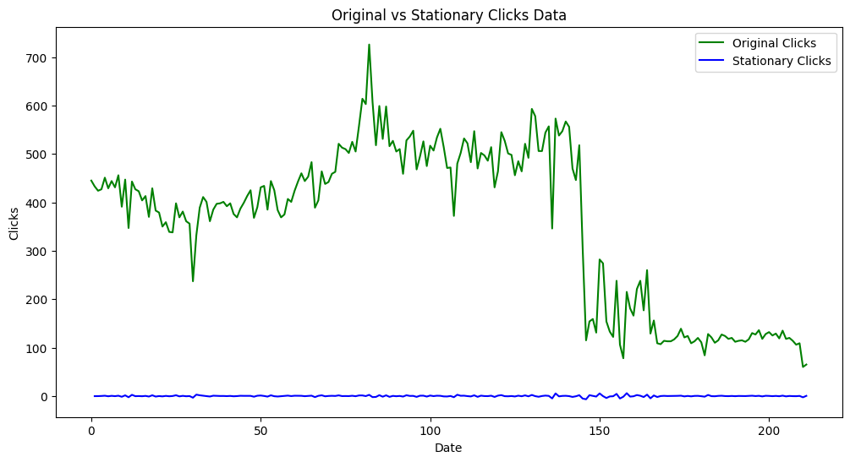
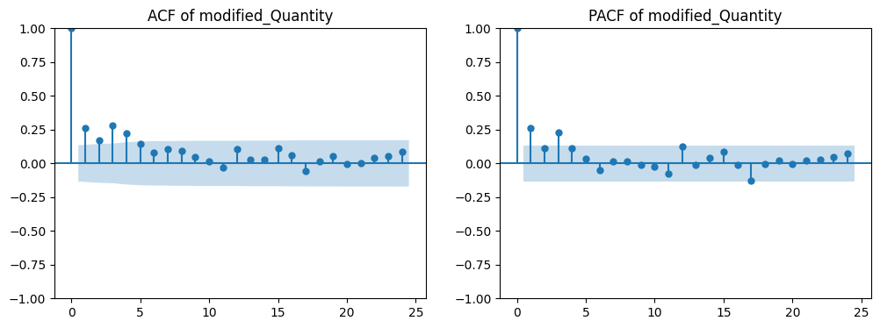
Time Series Hypothesis test
Stationarity test
By Stationarity test we get to know that ‘Quantity’ is stationary ‘Clicks’ is non stationary and ‘Impressions’ is stationary. So we converted ‘clicks’ to stationary.
ADF Statistics
From ADF Statistics we get to know that no. of lags in ‘Quantity’ is 1.
p value = 1, d value = 0 and q value = 1
ACF and PACF plot of Quantity
ADF Statistic for Quantity: -7.7867605772715045
p-value for Quantity: 8.140842681700413e-12
Number of lags used for Quantity: 1

Slide 18
TIME SERIES MODELS
Data Splitting :
To make the Time Series models we have considered the Exogenous variables ‘Day Index', 'Year', 'Month', 'Day', 'Clicks’, 'Impressions’ with the Target variable ‘'Quantity’.
We have considered a splitting ration – Training data : Validation data : Test data = 60 : 20 : 20
we take seasonal of 6 months.

Slide 19
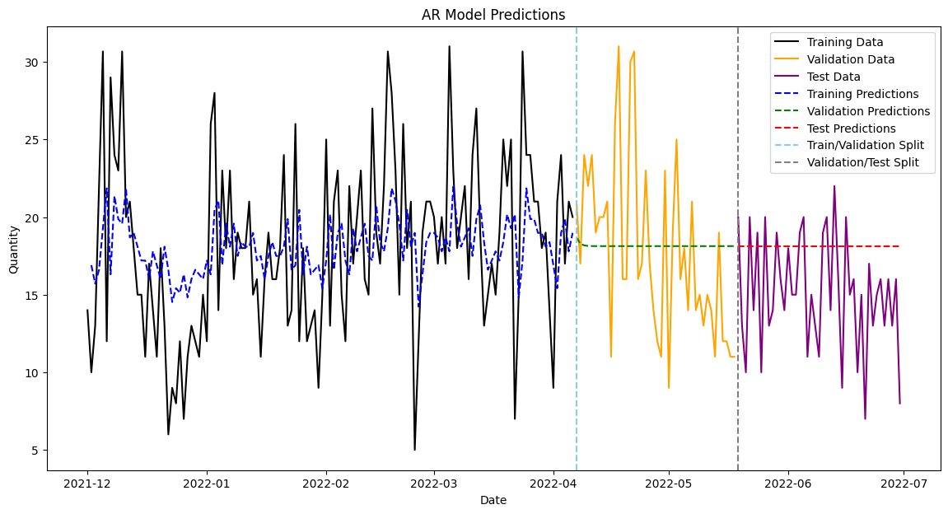
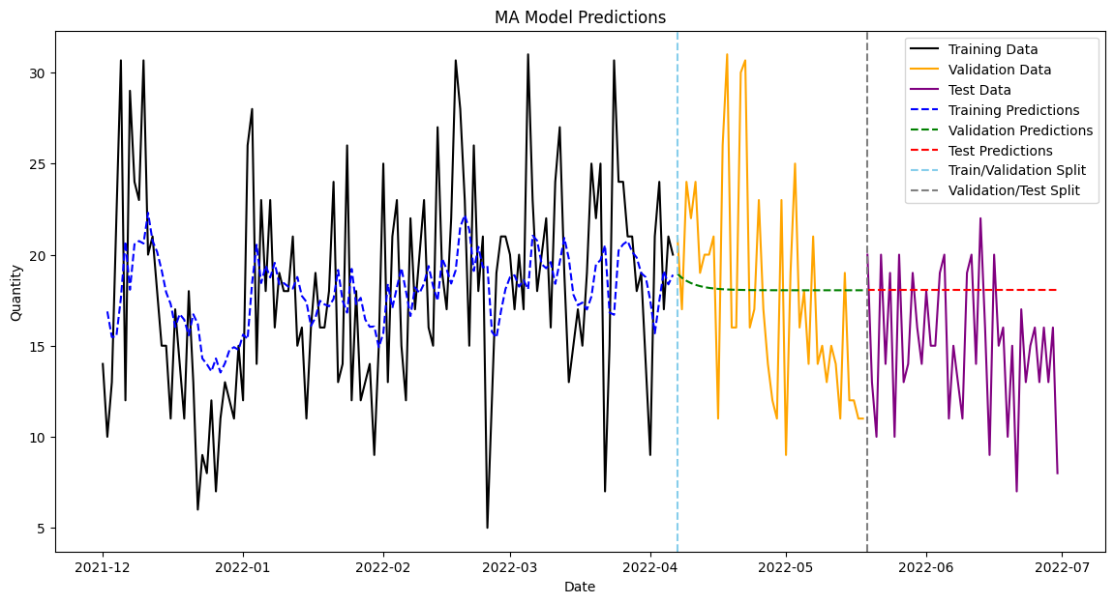
Autoregressive Model (AR) :
Moving Average Model (MA) :
AR Validation Set Metrics :
MSE: 31.46
RMSE: 5.61
MAE: 4.64
MAPE: 28.85%
R²: 0.00
Adjusted R²: -0.02
AR Test Set Metrics :
MSE: 22.37
RMSE: 4.73
MAE: 3.90
MAPE: 33.01%
R²: -0.70
Adjusted R²: -0.74
MA Validation Set Metrics :
MSE: 31.06
RMSE: 5.57
MAE: 4.59
MAPE: 28.51%
R²: 0.01
Adjusted R²: -0.01
MA Test Set Metrics :
MSE: 21.87
RMSE: 4.68
MAE: 3.86
MAPE: 32.64%
R²: -0.66
Adjusted R²: -0.70

Slide 20
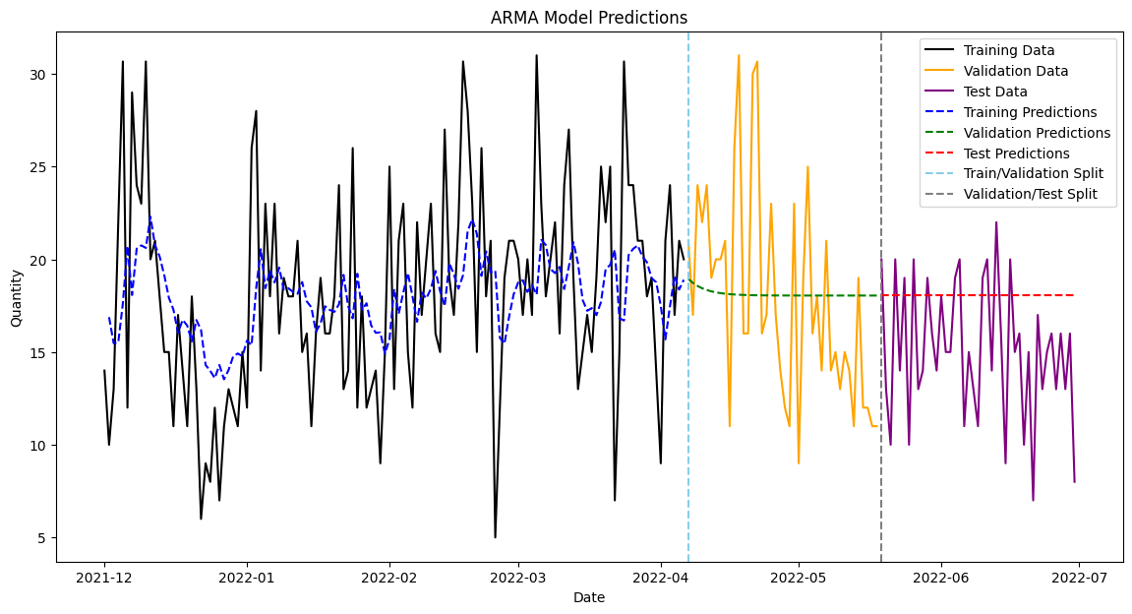

Autoregressive Moving Average Model (ARMA) :
Autoregressive Integrated Moving Average Model (ARIMA) :
ARMA Test Set Metrics :
MSE: 21.87
RMSE: 4.68
MAE: 3.86
MAPE: 32.64%
R²: -0.66
Adjusted R²: -0.70
ARMA Validation Set Metrics :
MSE: 31.06
RMSE: 5.57
MAE: 4.59
MAPE: 28.51%
R²: 0.01
Adjusted R²: -0.01
ARIMA Validation Set Metrics :
MSE: 31.06
RMSE: 5.57
MAE: 4.59
MAPE: 28.51%
R²: 0.01
Adjusted R²: -0.01
ARIMA Test Set Metrics :
MSE: 21.87
RMSE: 4.68
MAE: 3.86
MAPE: 32.64%
R²: -0.66
Adjusted R²: -0.70

Slide 21
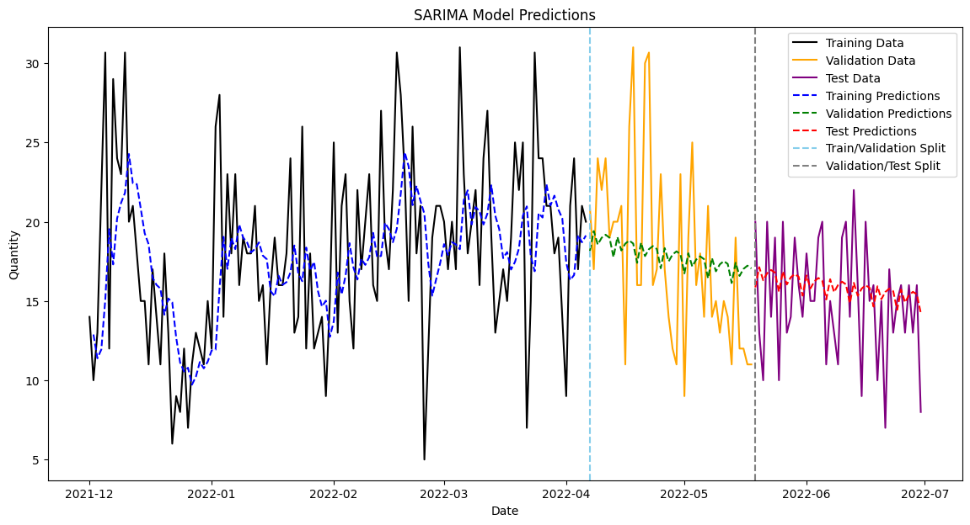
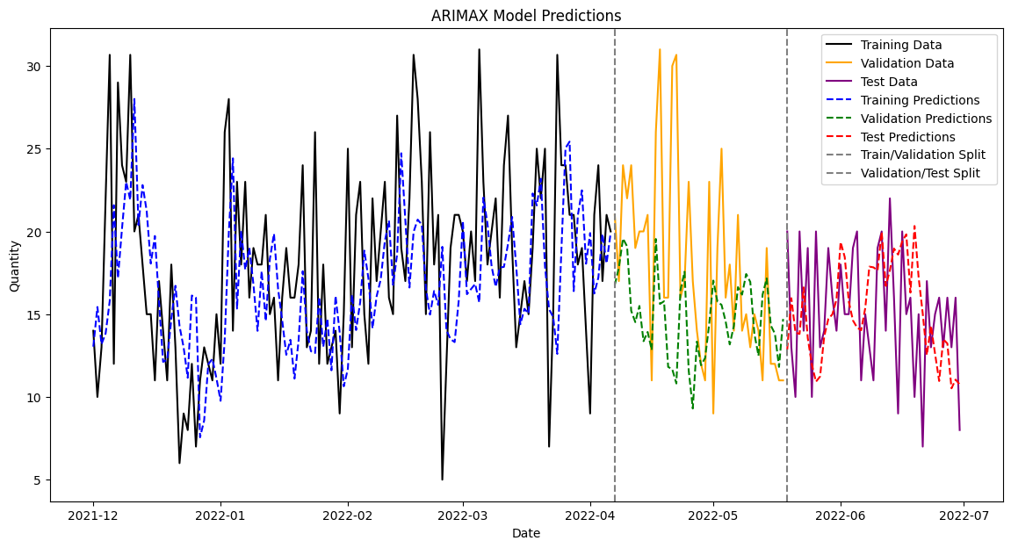
Seasonal Autoregressive Integrated Moving Average Model (SARIMA) :
Autoregressive Integrated Moving Average with Exogenous Variables Model (ARIMAX) :
SARIMA Validation Set Metrics :
MSE: 28.45
RMSE: 5.33
MAE: 4.38
MAPE: 26.56%
R²: 0.10
Adjusted R²: 0.07
SARIMA Test Set Metrics :
MSE: 12.27
RMSE: 3.50
MAE: 2.85
MAPE: 22.87%
R²: 0.07
Adjusted R²: 0.04
ARIMAX Validation Set Metrics:
MSE: 43.94
RMSE: 6.63
MAE: 4.75
MAPE: 24.35%
R²: -0.40
Adjusted R²: -0.55
ARIMAX Test Set Metrics:
MSE: 19.47
RMSE: 4.41
MAE: 3.57
MAPE: 26.67%
R²: -0.48
Adjusted R²: -0.64

Slide 22
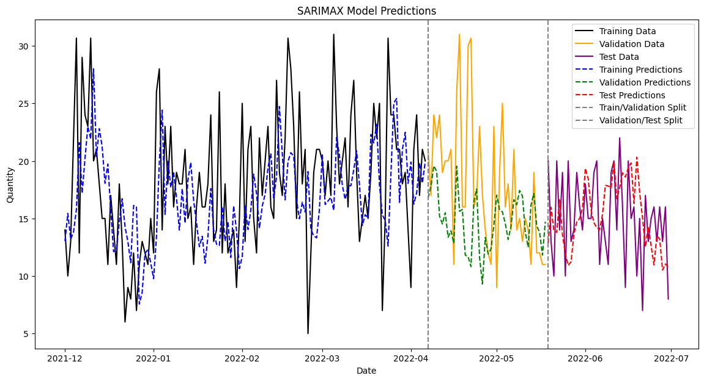
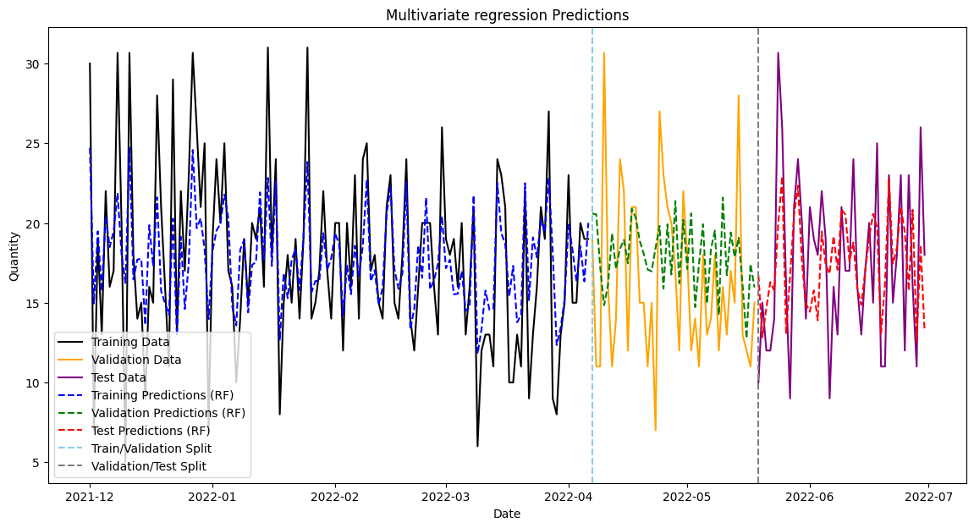
Seasonal Autoregressive Integrated Moving
Average with Exogenous Variables Model (SARIMAX) :
Multivariate Regression Model (MR) :
SARIMAX Validation Set Metrics:
MSE: 43.94
RMSE: 6.628
MAE: 4.75
MAPE: 24.35%
R²: -0.40
Adjusted R²: -0.55
SARIMAX Test Set Metrics:
MSE: 19.47
RMSE: 4.412
MAE: 3.57
MAPE: 26.67%
R²: -0.48
Adjusted R²: -0.64
MR Validation Set Metrics:
MSE: 29.19
RMSE: 5.40
MAE: 4.25
MAPE: 30.09%
R²: -0.09
Adjusted R²: -0.20
MR Test Set Metrics:
MSE: 18.69
RMSE: 4.32
MAE: 3.48
MAPE: 22.61%
R²: 0.29
Adjusted R²: 0.22

Slide 23
Comparison of All Models
Comparison table for Validation Set Matrices :
Comparison table for Test Set Matrices :
Model | MSE | RMSE | MAE | MAPE | R² | Adjusted R²
AR | 31.46 | 5.61 | 4.64 | 28.85 | 0.00 | -0.02
MA | 31.06 | 5.57 | 4.59 | 28.51 | 0.01 | -0.01
ARMA | 31.06 | 5.57 | 4.59 | 28.51 | 0.01 | -0.01
ARIMA | 31.06 | 5.57 | 4.59 | 28.51 | 0.01 | -0.01
SARIMA | 28.45 | 5.33 | 4.38 | 26.56 | 0.10 | 0.07
ARIMAX | 47.41 | 6.89 | 5.06 | 24.92 | -0.40 | -0.55
SARIMAX | 47.41 | 6.89 | 5.06 | 24.92 | -0.40 | -0.55
MR | 29.19 | 5.40 | 4.25 | 30.09 | -0.09 | -0.20
Model | MSE | RMSE | MAE | MAPE | R² | Adjusted R²
AR | 22.37 | 4.73 | 3.90 | 33.01 | -0.70 | -0.74
MA | 21.87 | 4.68 | 3.86 | 32.64 | -0.66 | -0.70
ARMA | 21.87 | 4.68 | 3.86 | 32.64 | -0.66 | -0.70
ARIMA | 21.87 | 4.68 | 3.86 | 32.64 | -0.66 | -0.70
SARIMA | 12.27 | 3.50 | 2.85 | 22.87 | 0.07 | 0.04
ARIMAX | 15.62 | 3.95 | 3.36 | 23.67 | -0.48 | -0.64
SARIMAX | 15.62 | 3.95 | 3.36 | 23.67 | -0.48 | -0.64
MR | 18.69 | 4.32 | 3.48 | 22.61 | 0.29 | 0.22
From the table of Validation Set Matrices we get:
SARIMA model has the lowest MSE (28.45), RMSE (5.33), MAE (4.38), and relatively lowest MAPE (26.56%), along with the highest R² (0.10) and Adjusted R² (0.07).
From the table of Test Set Matrices we get:
SARIMA model has the lowest MSE (12.27), RMSE (3.50), MAE (2.85), and relatively lowest MAPE (22.87%) along with the highest R² (0.07) and Adjusted R² (0.04).
As we are given only 7 months of data, that’s why we are getting R² and Adjusted R² value in negative form in all the Time series Models.

Slide 24
Conclusion
Based on Validation Set Matrices comparison and Test Set Matrices comparison we get SARIMA model is the best model overall.
Final Model SARIMA – Actual vs Forecast plot
SARIMA Validation Set Metrics :
MSE: 28.45
RMSE: 5.33
MAE: 4.38
MAPE: 26.56%
R²: 0.10
Adjusted R²: 0.07
SARIMA Test Set Metrics :
MSE: 12.27
RMSE: 3.50
MAE: 2.85
MAPE: 22.87%
R²: 0.07
Adjusted R²: 0.04
The SARIMA model shows a moderate fit for the dataset, evidenced by the validation and test metrics. The validation set R² of 0.10 and adjusted R² of 0.07 indicate limited explanatory power, with an RMSE of 5.33 suggesting variability in predictions. The test set results show improvement, with lower MSE and RMSE, and a slightly better R² of 0.07 and adjusted R² of 0.04, indicating some model generalizability. However, the high MAPE values (26.56% for validation and 22.87% for test) suggest that prediction accuracy is still relatively low.

Slide 25










References
These are some platforms & websites which helped me to find data and knowledge to complete my project.
infyspringboard.onwingspan.com
edx.org
Coursera.org
kaggle.com
google.com
youtube.com
datacamp.com
realpython.com
archive.ics.uci.edu
VS Code

Slide 26
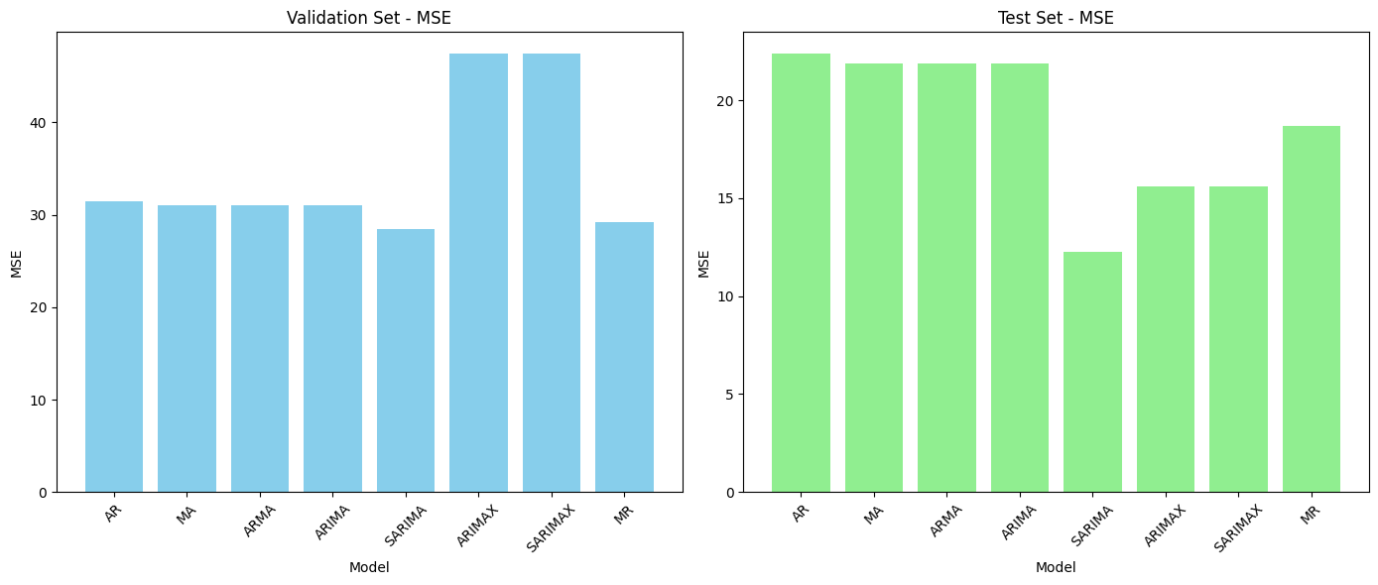
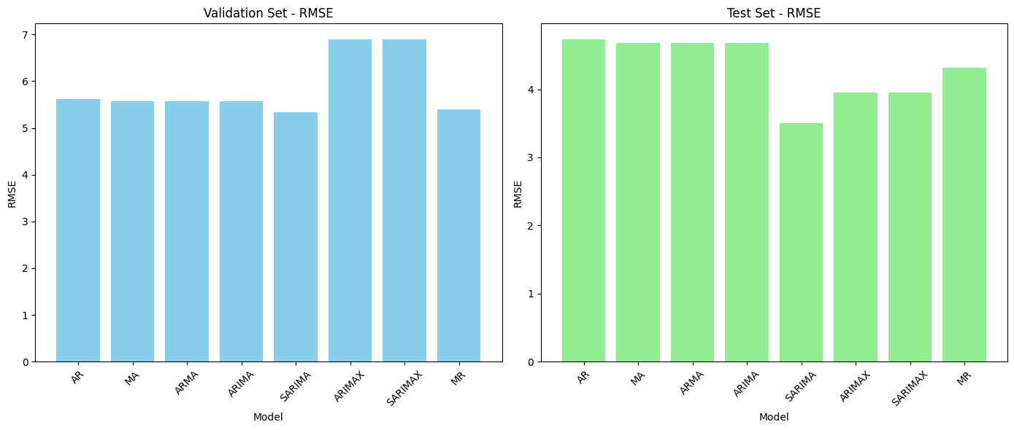
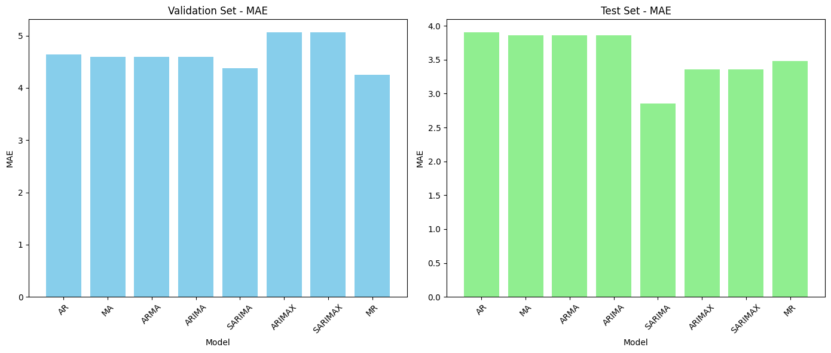
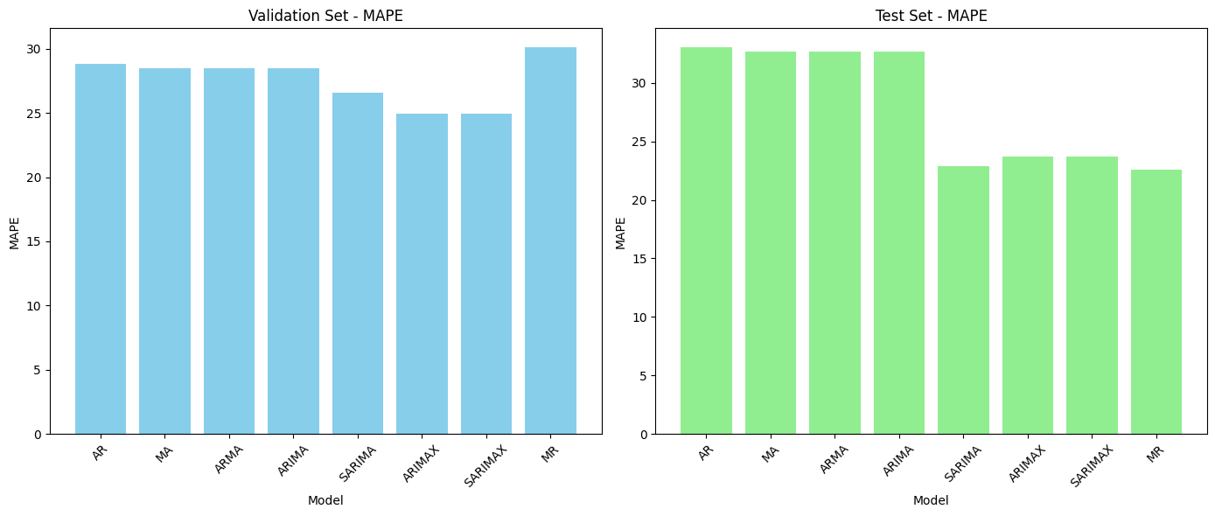
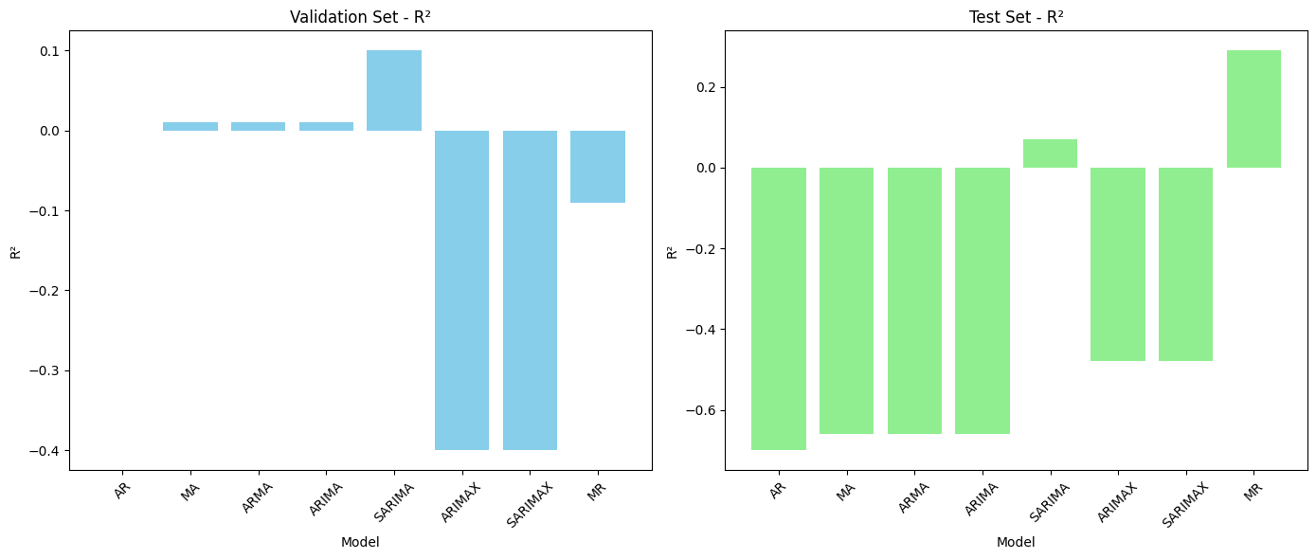
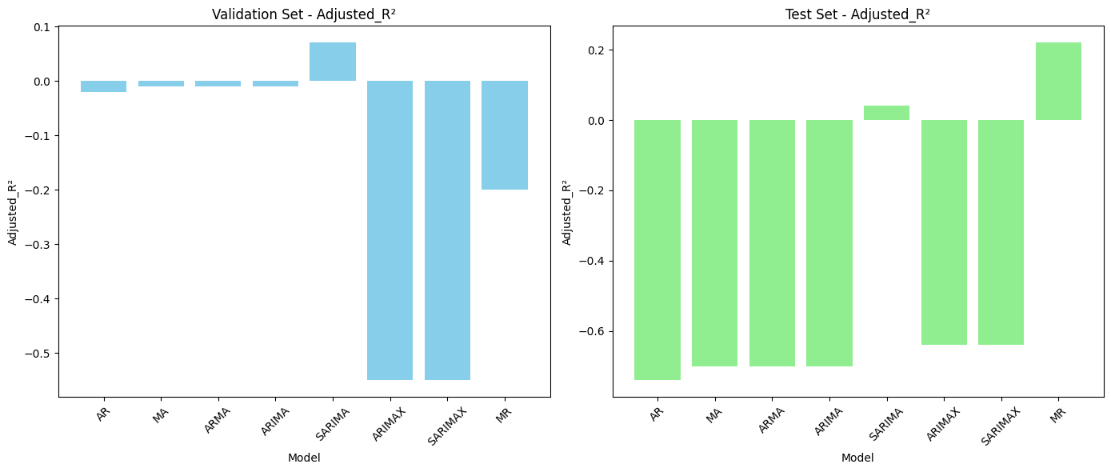
Anexer : Plot of all model results

Slide 27
Thank you!
I would like to express my heartfelt gratitude to all the viewers for taking time out of their busy schedules to attend my presentation. Your presence and attention has been invaluable to me.

